Slide 1

Crime Rate per Capita Income US Counties
Project 3
Team 3
Kevin Ybarra
Satya Sakuntala NagaSravya Mattapalli
Chris Schultz
Wei Kent Chen

Slide 2
Project Overview
Team 3 project compares United State counties per capita income and crime rate.
Question - which states and counties had the most or which crime was the most prevalent based by income?
Our project gathers data on counties per capital income and crime rate in the United States, as well GeoJSON data to map out counties in the United States.

Slide 3
Data Sources
Kaggle - United States counties by per capita income
Kaggle - United States crime rates by county
GeoJSON - US Counties

Slide 4
Transform Data
Counties per Capita Income
Replaced all dollar's signs and commas to be readable.
Reconfigured the D types of the variables and sorted by household income and realigned the index to excluding the 0 to rank them.
Renaming of headers.
Copied the state name and turned into abbreviations.
Crime Rate by County
String split using the commas to separate the county name and state abbreviation and added into a new column
Added zeros to the FIPS state and city to form two digits and three digits respectively to form a FIPS code
Added the 8 major groups of violent crimes to form a total violent crime column.
Remove all names of county borough to match the other data
Merging Data Sets
Before merging we confirmed data types were similar.
Empty spaces were present before the values in the rows and columns removed to allow merging of data sets.
Based on FIPS added Lat /Long columns

Slide 5
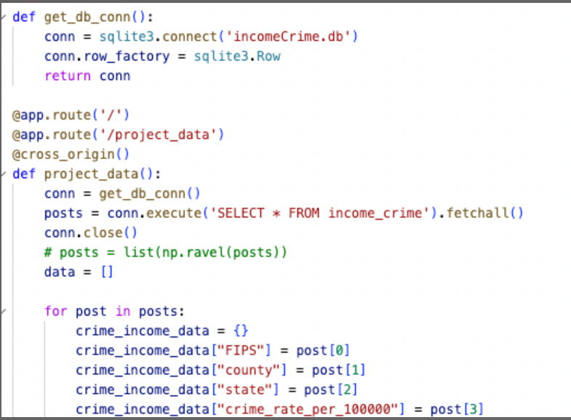
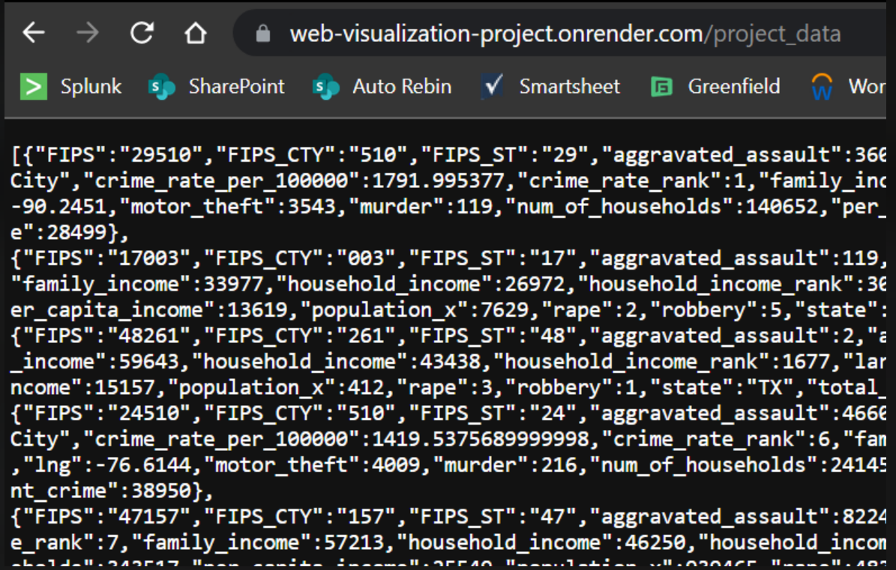
Load Data
To load used SQLite3
Using the Flask app we pulled data from SQLite Database and created API rest end point
Used render powered by Flask app.

Slide 6
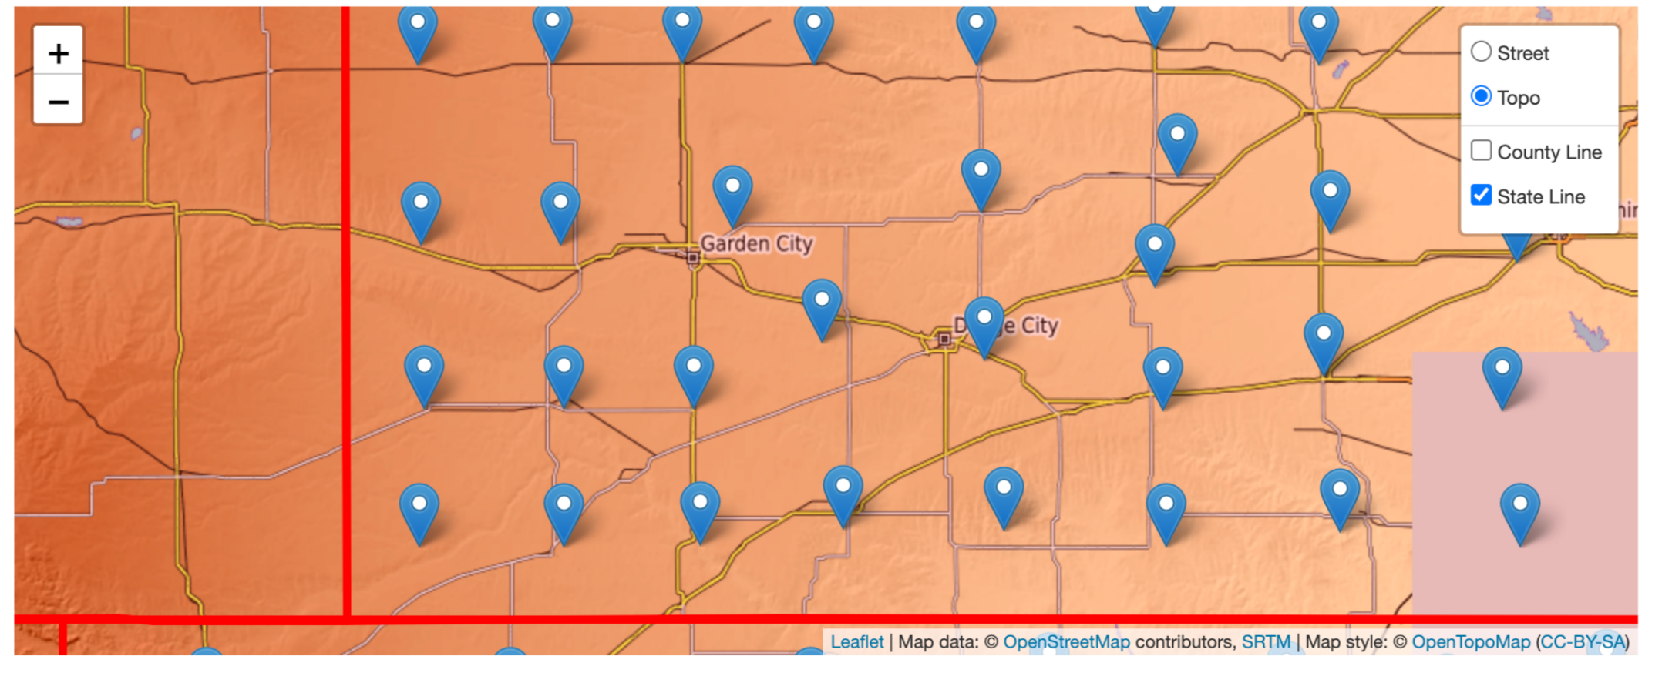
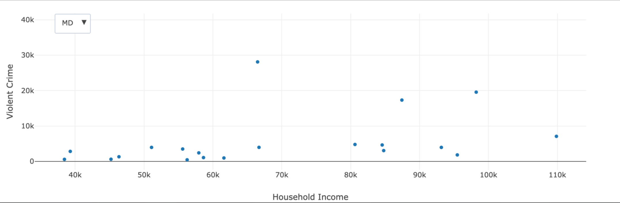
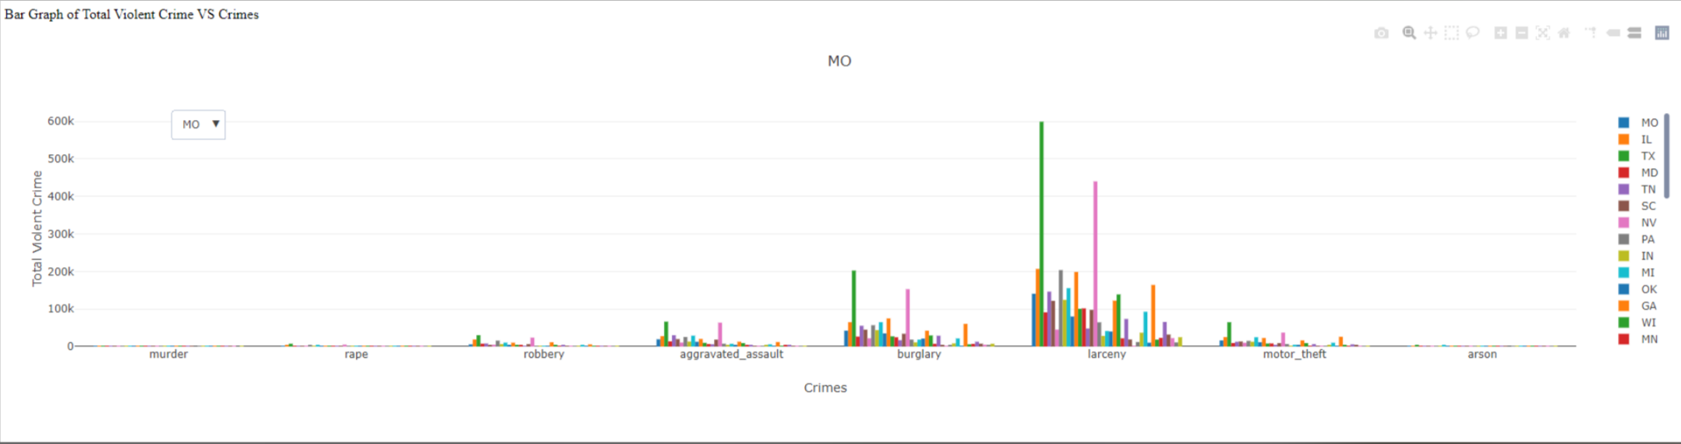
Website Development
Showing Counties or States that report Crime Data
Showing household income and total violent crime by state dropdown
Showing household income and total violent crime by state dropdown
Household Income

Slide 7
Crime Rate per Capita Income US Counties
https://mattapallisravya.github.io/Web_visualizations_Project3/
Team 3
Kevin Ybarra
Satya Sakuntala NagaSravya Mattapalli
Chris Schultz
Wei Kent Chen

Slide 8
Website Development
What would we do different?
Add more time
Drill down on more specific data points for example prison time by crime type
Additional Interactive Graphs
Deeper dive on the markers

